Slide 1
HBase

Slide 2
Background
HBase is a wide column storage database designed for either transactions or analytics processing, and it is built on top of HDFS. In this video, we will compare how it performs for certain operations with the other popular wide column data store, Cassandra.
HDFS provides high latency writes and reads (since they all come directly from disk), and only allows for sequential writes as opposed to in the middle of a file - we will see how using an LSM tree based architecture HBase can mitigate this issue and provide low latency writes and reads on random accesses.

Slide 3
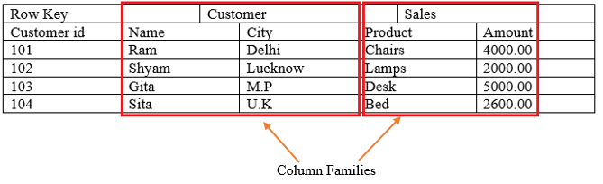
Data Model
Wide column format:
Each row has a single row key, and any columns that they want (or column families which consist of multiple values)
The row key can be comprised of multiple parts which allows the sorting of rows within a table

Slide 4
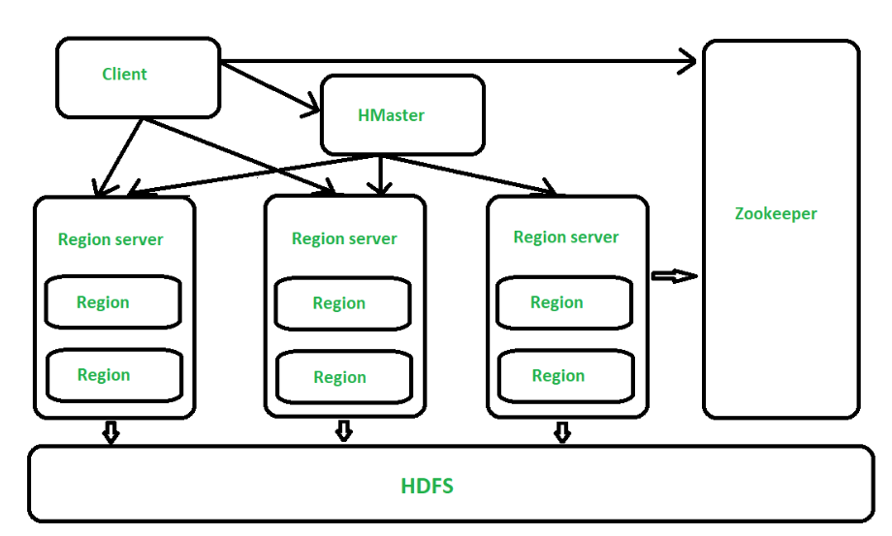
Architectural Overview
Master server
Region server
Replication

Slide 5
Master Server
Many parallels to HDFS NameNode:
Stores all file metadata, as well as the locations of the chunks of files
Keep in mind that this is effectively the partitioning schema of HBase
Range based partitioning that can be split if too big, based on row key
For both reads and writes, client first reaches out to master server in order to figure out the location of the file that it will be reading to and writing from
Can be used in conjunction with ZooKeeper to replicate its write ahead log and thus support a backup master node, increases fault tolerance

Slide 6
Region Server
Run as a separate thread on HDFS datanode servers:
Occasionally send heartbeats to ZooKeeper so master knows they are alive
Uses an LSM tree style in memory data structure where writes are first sent (in addition to a write ahead log for persistence)
Once the LSM tree becomes too large, writes are flushed to sorted HFiles
Basically the same as an SSTable
SSTables stored in column oriented format
Good for high read throughput and analytics over a range of the row key

Slide 7
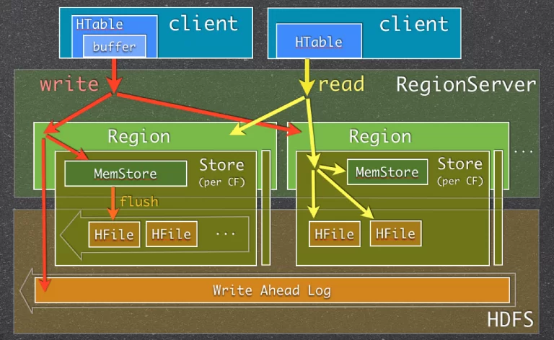
Replication
Recall: Region nodes, occasionally will write new HFiles (similar to SSTables).
Since the region node is (usually) running on an HDFS replication node, it uses the HDFS replication pipeline to synchronously replicate the HFile to other nodes.

Slide 8
Analytics Perspective
Column oriented storage (all elements of a column family stored in one file) make for very high read throughput of one column
Being built on HDFS allows for good integration with both MapReduce and dataflow engines (Spark, Tez) for high throughput analytics
Use batch processes to perform joins! Joins are not supported in HBase

Slide 9
Conclusion
While HBase looks very similar to Cassandra on a surface level, they serve very different use cases!
Cassandra:
Real time transactions processing database, super fast writes
HBase:
Great as a data lake for running huge batch/streaming processes on, also capable of fast reads and writes
If you want to support more structured data with advanced queries, opt for a SQL based data warehouse

